Slide 1





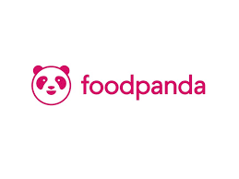



Market Expansion
Pushpak Viman will be delivering products almost all over India through the drone delivery services.
Tie up with government services.
  Postal
  Courier service
Private Delivery Services.
  Delhivery
  Ecom
Client base will include E-commerce vendors of Food Services and Pharmaceutical
  Zomato
  Swiggy
  FoodPanda
  Dunzo
  NetMeds
Local Vendors
Tie up with Online Shopping Market.
  Myntra
  Flipkart

Slide 2
Marketing Overview
Target Clients
Promotional Methods
Marketing Budget.
Competitors
Marketing Trends.
  Current Marketing trends are all about social distancing, and handsfree, no human interaction can be achieved with these drones.
  Also providing discounts, coupons and other offers.

Slide 3
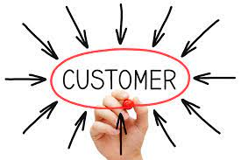
Target Clients
Zomato has over 1.4 million listed restaurants and 12,000 restaurant partners. Moreover, it has over 6500 restaurant partners for Zomato Gold.
Swiggy is attending 1.5 million orders a day and has about 20 million monthly active users.
The Bengaluru-based firm doubled its active userbase from 2.7 million to 5.1 million from 2019 to 2020.
Netmeds.com has a customer base of nearly one million people. And have delivered to more than 800 cities, towns and villages in more than 12,000 pin codes.
Flipkart has enabled millions of consumers, sellers, merchants, and small businesses to be a part of India's digital commerce revolution, with a registered customer base of more than 350 million.
Myntra will offer 1 million styles and 7,000 brands across categories and said it had increased the number of brands on the platform by 40% over the previous edition.

Slide 4




Promotional Methods
Promotional Video
Advertisements
Billboards
Organic Search (SEO)
Social Media Marketing
  Instagram, Facebook, Twitter, LinkedIn etc.
  Google Ads, Facebook Ads.

Slide 5
Budget for Marketing
Total Budget | 7500000
Promotional Video | 500000
Advertisements(TV and Radio) | 4000000
Billboards | 660000
Organic Search (SEO) | 200000
Social Media Marketing | 2000000

Slide 6
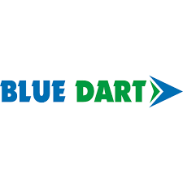



Competitors
Blue Dart has a reach of 35,000+ pin codes in India and 220+ countries globally. They offer multiple payment packages that bundle services together.
Covering 26000+ pin codes across the country, DHL maintains a high standard when it comes to reducing wastage in the delivery process and reducing each company’s environmental footprint.
DTDC offers eCommerce businesses the option of customizing deliveries as per customer preferences, in addition to services like COD, collect-on-delivery, bulk shipping, heavyweight shipping and express delivery.
GATI Delivery was started in 1989 to optimize distribution for retailers and now for online businesses. It currently serves 19000+ pin codes within the country.

